Slide 1
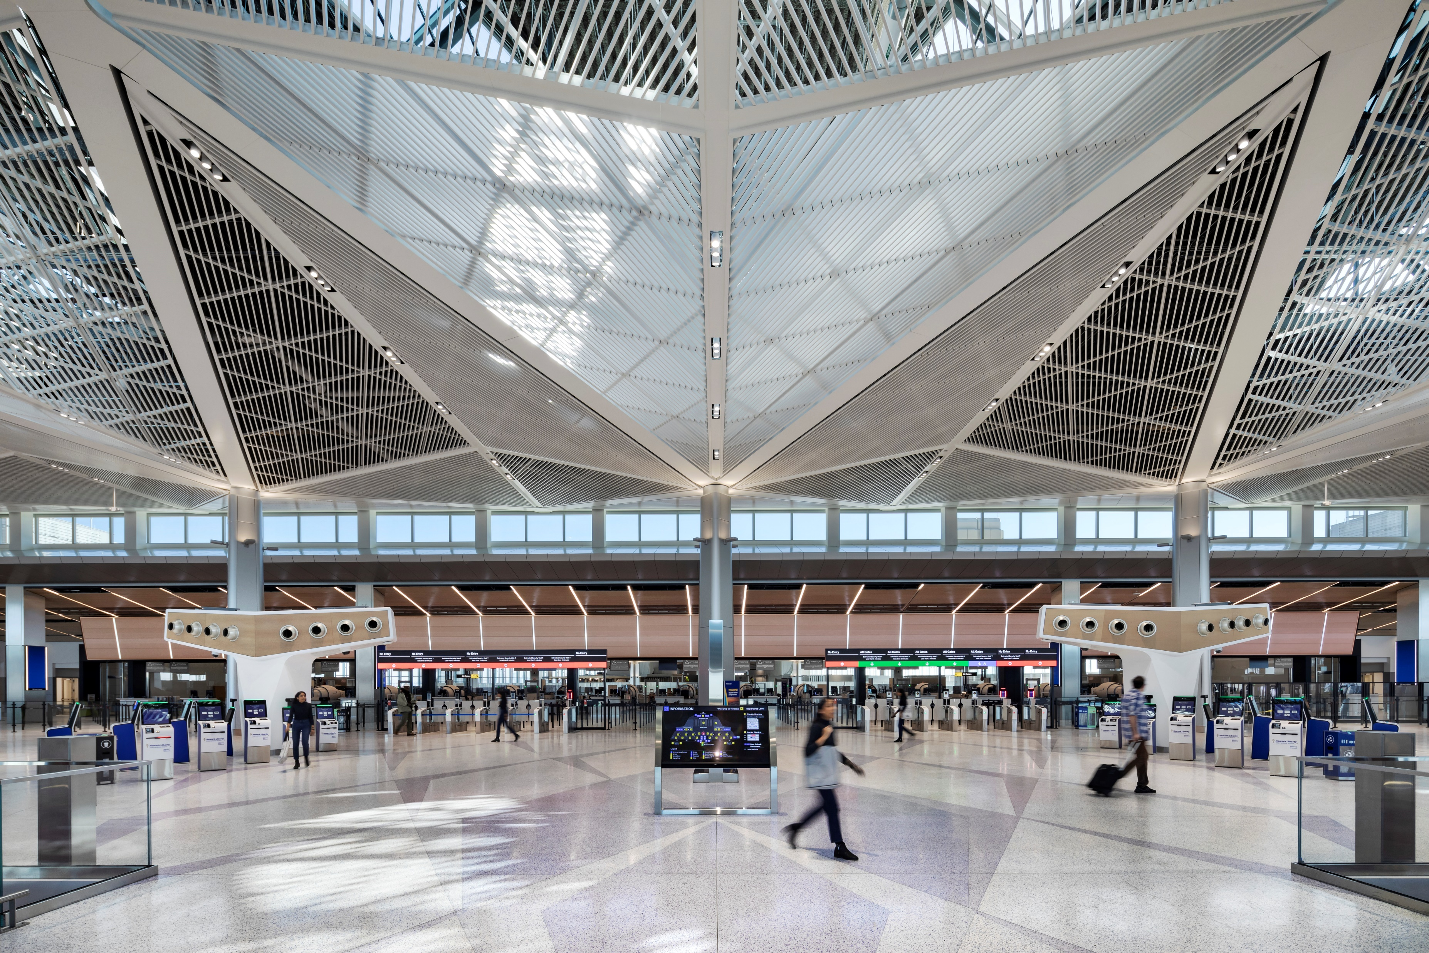
Newark Liberty International Airport New Terminal A
Elizabeth, NJ

Slide 2
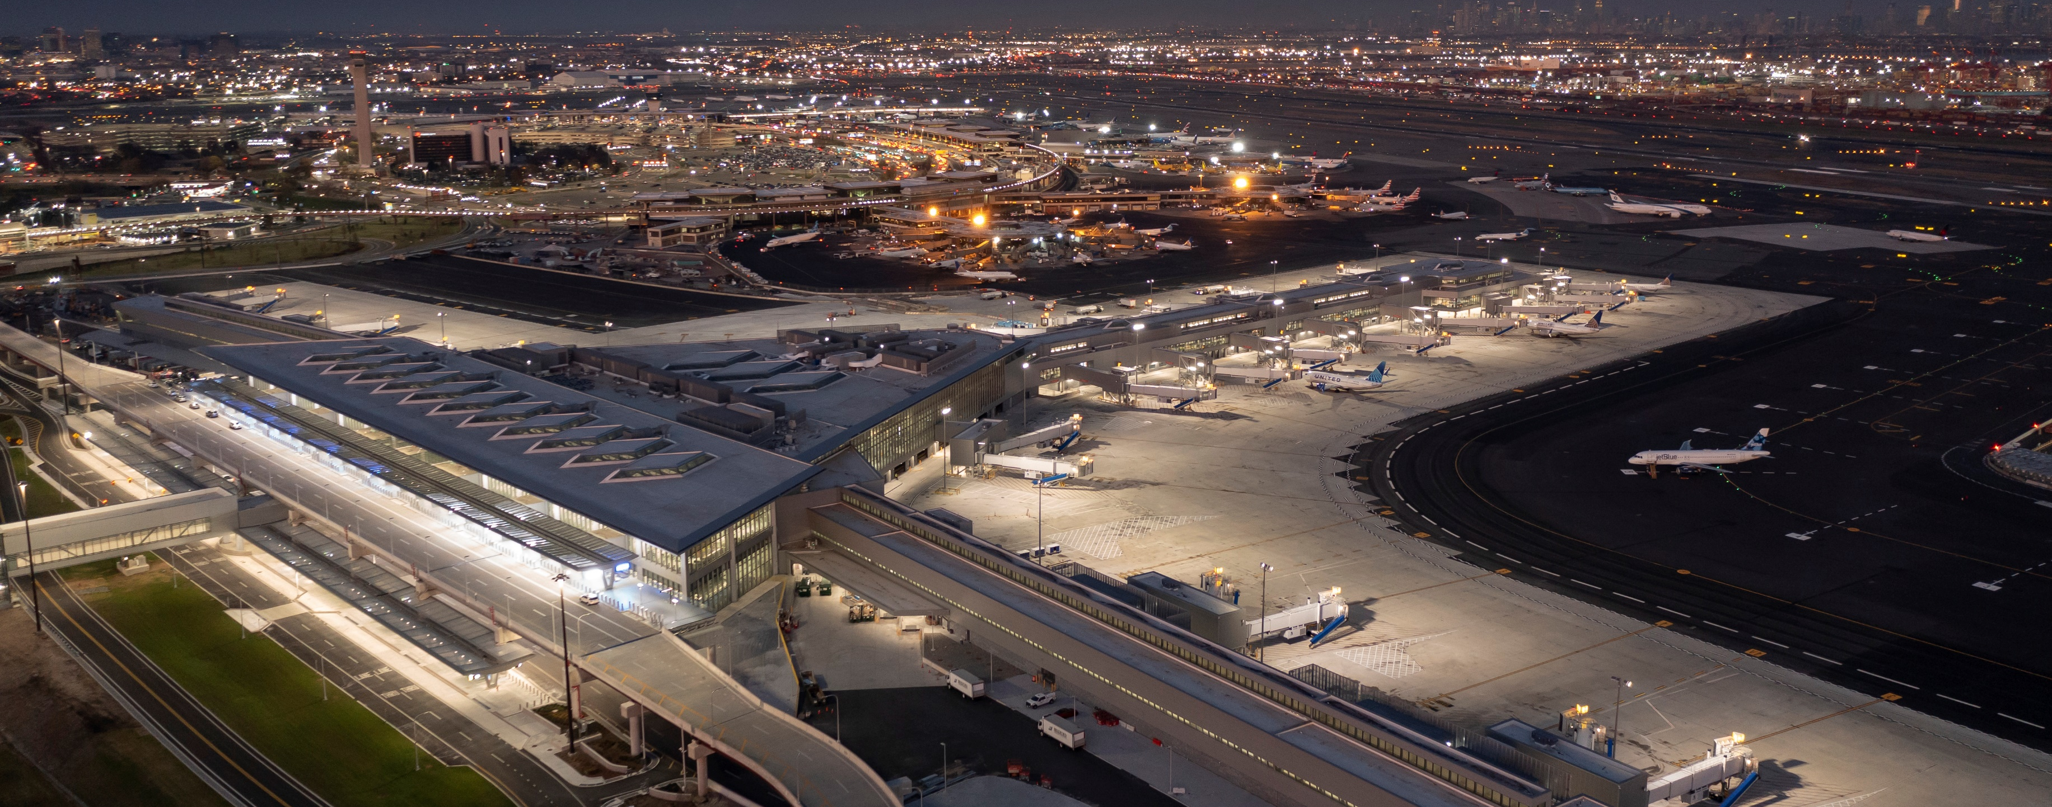
Photo 1: The new Terminal A at Newark Liberty International Airport opened in January 2023 and can accommodate more than 13.6 million annual passengers. The new Terminal A was the largest design-build infrastructure project in New Jersey state history. Photo credit: James Ewing

Slide 3
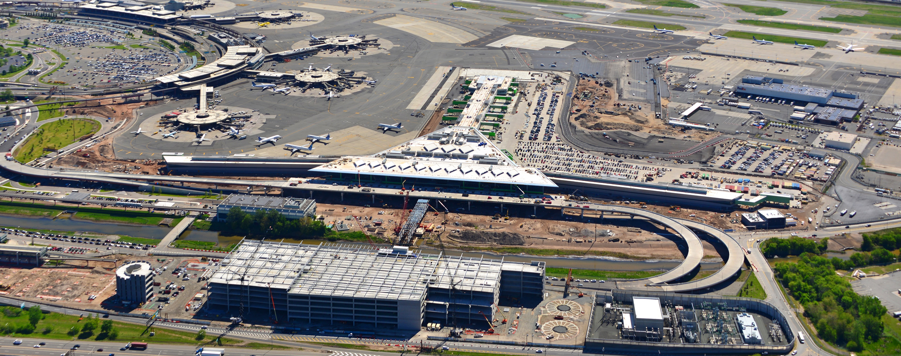
Photo 2: Newark is one of the region’s three major airport gateways, and the new Terminal A creates a distinct destination experience for passengers. In addition to the terminal building, the program includes eight new bridges and roadways, a new car rental and parking facility, and 1.4 acres of airfield paving improvements. Note: This image cannot be used publicly and is for internal purposes only.

Slide 4
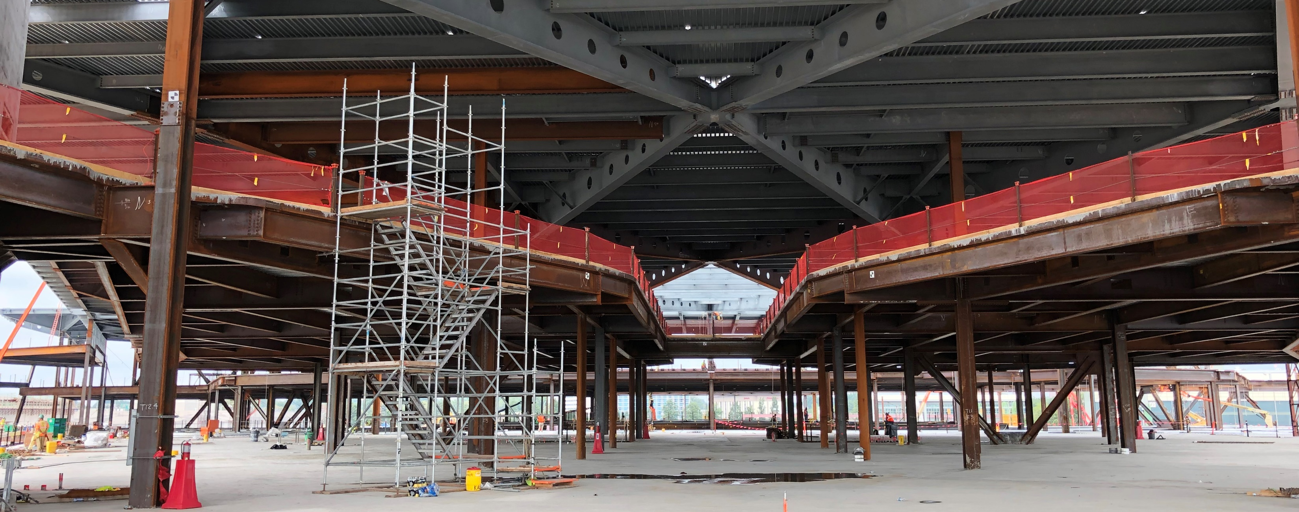
Photo 3: The new three-level terminal building is T-shaped, comprised of a central headhouse and a single secure concourse. To achieve the architectural vision for the building, the structural team was tasked with minimizing the number of columns in the departures hall and main concourse to create a large, open space, while also overcoming stringent design criteria. Note: This image cannot be used publicly and is for internal purposes only.

Slide 5
Photo 4: The brand-new departures and arrivals hall is distinguished by its sloping, diagrid ceiling. Expected to generate over $4.6 billion for the regional economy, the LEED Gold terminal features key sustainability components such as a “cool roof” to reduce heat gain and regionally sourced, recycled, and low-emitting materials to improve indoor air quality. Photo credit: James Ewing

Slide 6
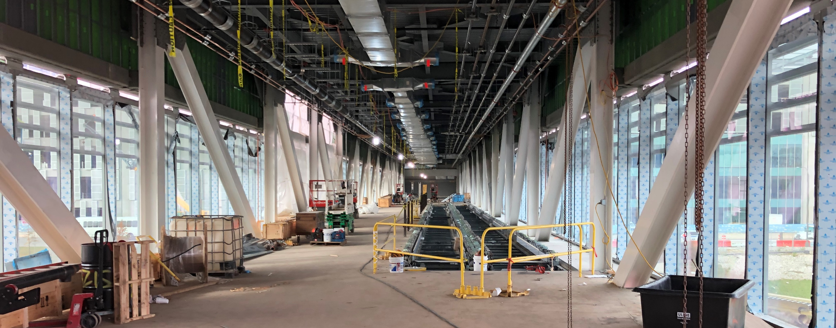
Photo 5: Custom fabricated steel strongbacks and secondary steel elements support the floor-to-ceiling glass windows and meet the project’s strength and aesthetic requirements. Note: This image cannot be used publicly and is for internal purposes only.

Slide 7
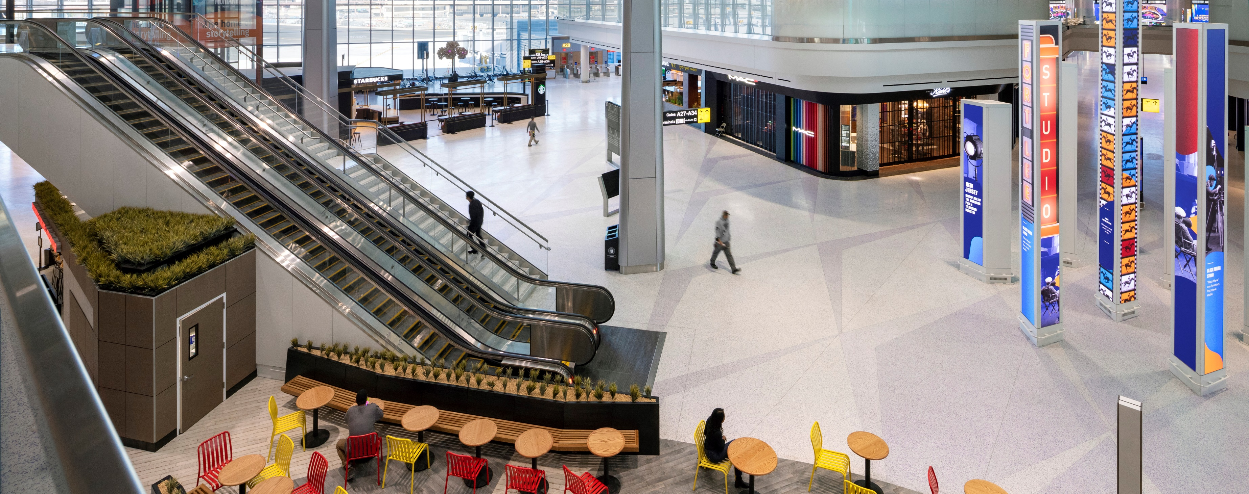
Photo 6: Travelers now encounter a modernized, streamlined airport experience featuring the latest technology, such as facial recognition and electronic boarding gates. The terminal features a fully automated security screening checkpoint. Photo credit: James Ewing

Slide 8
